Slide 1

My Reads
Udacity REACT Project

Slide 2
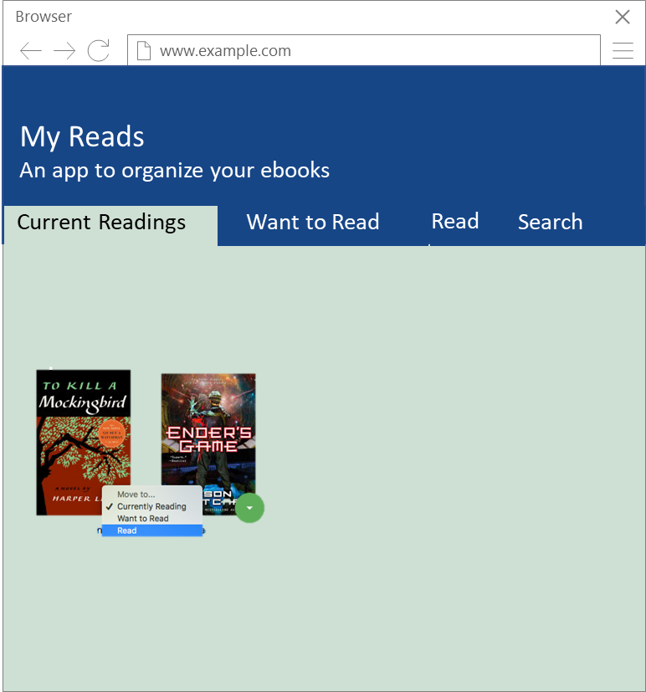
App Main Page
In this application, the main page displays a list of "shelves" (i.e. categories), each of which contains a number of books. The three shelves are:
Currently Reading
Want to Read
Read
The main page also has a search tab, a search page that allows you to find books to add to your library.
The search page has a text input that may be used to find books. As the value of the text input changes, the books that match that query are displayed on the page, along with a control that lets you add the book to your library.
© All rights reserved. Designed by Gustav Willig

Slide 3
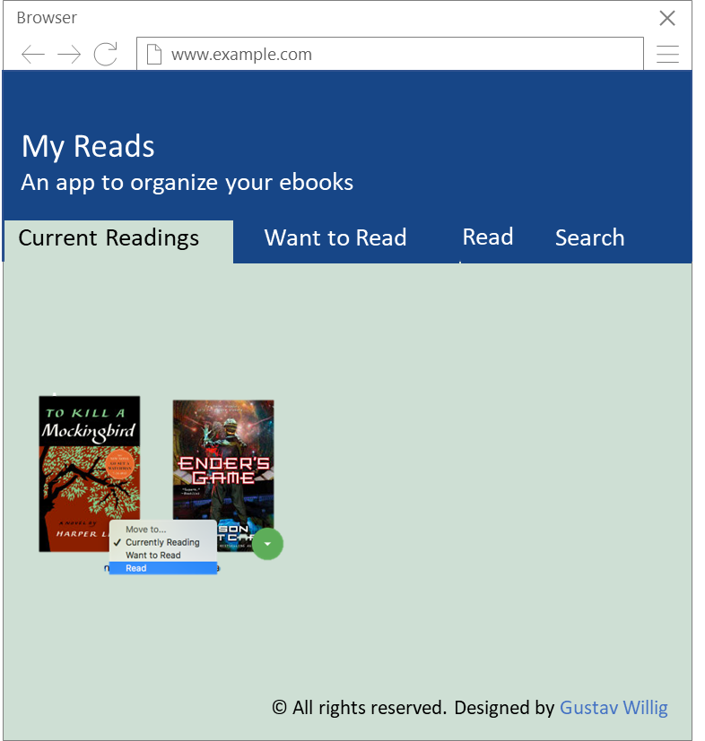
Header
Title
Description
Tabs
Cards
Books
Move Button
Footer
Footnote
Title
Description
Tabs
Article
Move Button
Foot Note

Slide 4
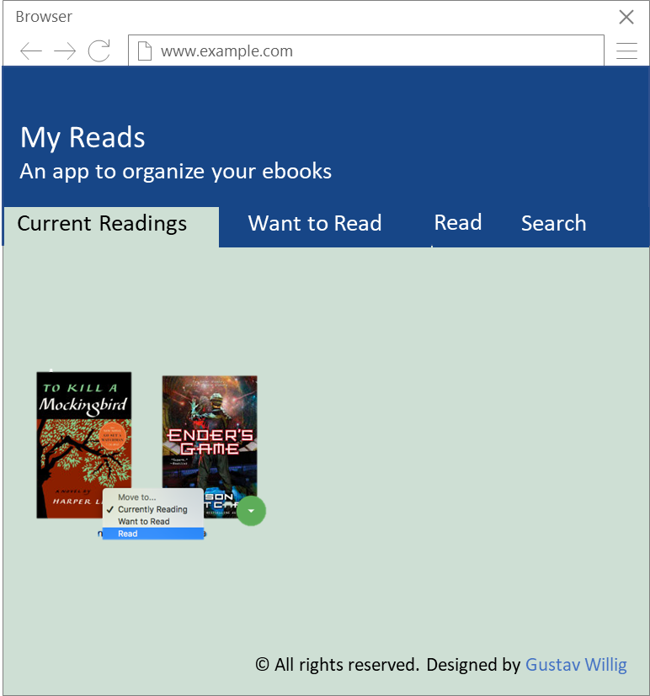

Slide 5
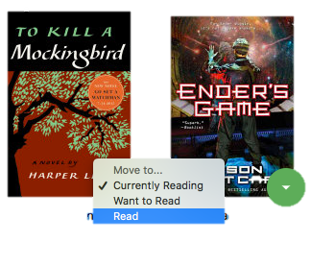
App Functionality Search Page
Browser
Browser
www.example.com
www.example.com
My Reads
An app to organise you ebooks
My Reads
An app to organise you ebooks
Current Readings
Want to Read
Current Readings
Want to Read
Read
Search by Autor
The main page also has a link to /search, a search page that allows you to find books to add to your library.
The search page has a text input that may be used to find books. As the value of the text input changes, the books that match that query are displayed on the page, along with a control that lets you add the book to your library. To keep the interface consistent, you may consider re-using some of the code you used to display the books on the main page
. he search page also has a link to / (the root URL), which leads back to the main page.
When you navigate back to the main page from the search page, you should instantly see all of the selections you made on the search page in your library.
+
+
Browser
www.example.com
www.example.com
My Reads
An app to organise you ebooks
My Reads
An app to organise you ebooks
Harper..
Current Readings
Want to Read
Read
+
+

Slide 6
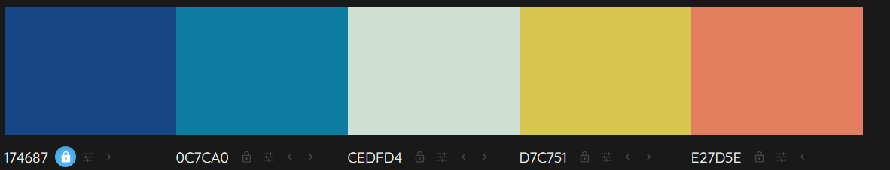
App Functionality
Color Schema

Slide 7
Addition material

Slide 8
Browser
www.example.com
My Reads
An app to organize your ebooks
Current Readings
Want to Read
Read
Search
© All rights reserved. Designed by Gustav Willig

Slide 10
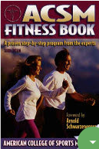
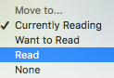
Design Main Page v0.5
Browser
www.example.com
My Reads
An app to organise you ebooks
Current Readings
Want to Read
Read
+

Slide 11
Browser
Browser
Browser
Browser
www.example.com
www.example.com
www.example.com
www.example.com
My Reads
An app to organise you ebooks
My Reads
An app to organise you ebooks
My Reads
An app to organise you ebooks
My Reads
An app to organise you ebooks
Current Readings
Want to Read
Read
Search by Autor
Harper..
Current Readings
Want to Read
Read
+
+
+
+

